Slide 1
Imagine…

Slide 2
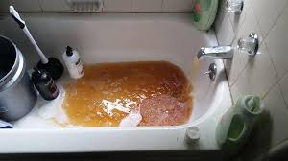

Slide 3
What’s been your life experience with water quality?
Notes:
3

Slide 4
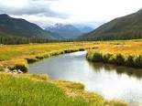

Slide 5
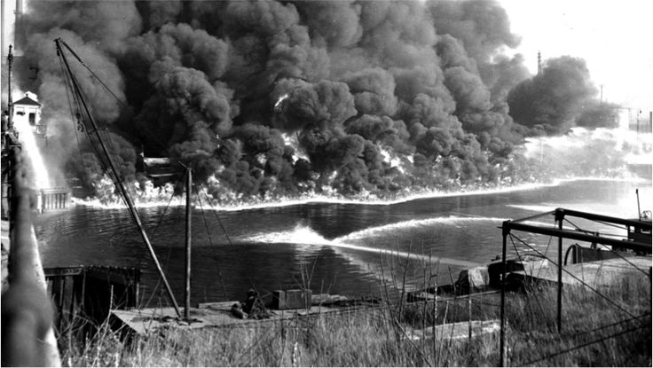
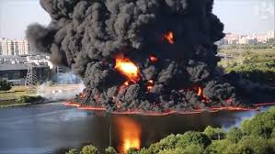

Slide 6
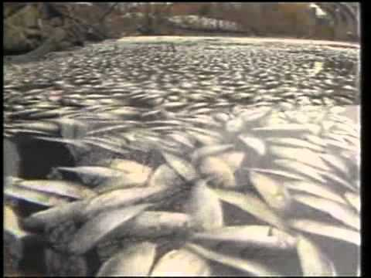

Slide 7
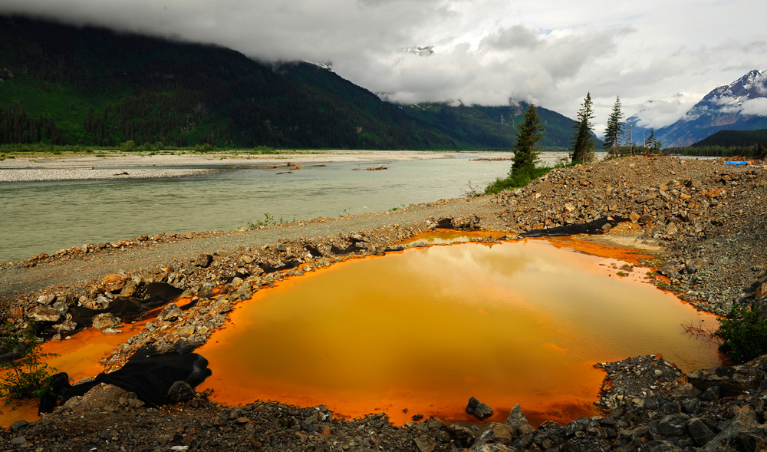

Slide 8
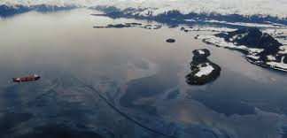

Slide 9
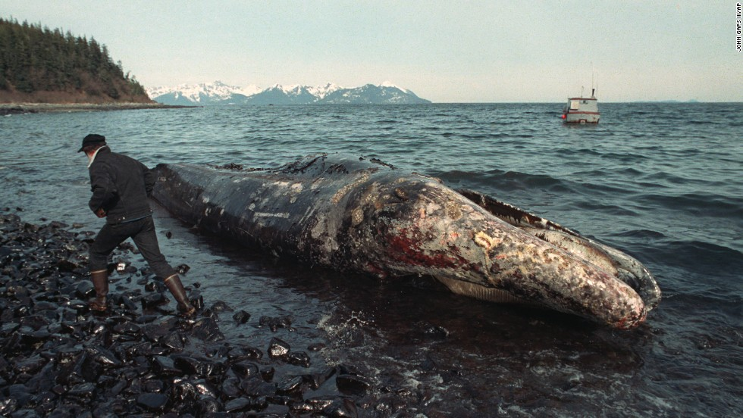

Slide 10
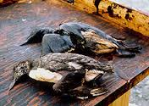

Slide 11
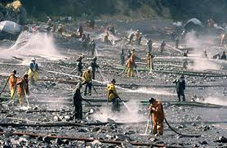

Slide 12
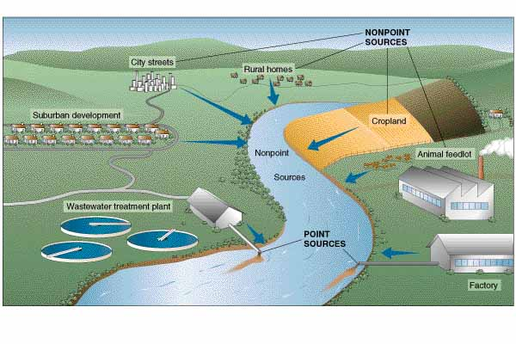
Sources of Pollution

Slide 13
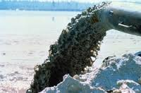
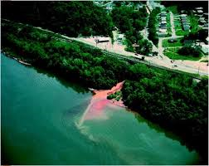

Slide 14
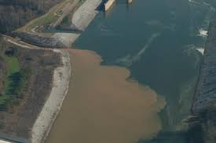
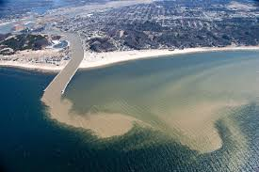

Slide 15
How can you prevent this from happening everywhere sources of contamination exist?
  Education!
  Laws!
  *Point or Non-Point Sources?
Notes:
15

Slide 16
What’s the point of water monitoring anyway?

Slide 17
Dissolved Oxygen/Temperature and Nutrients

Slide 18
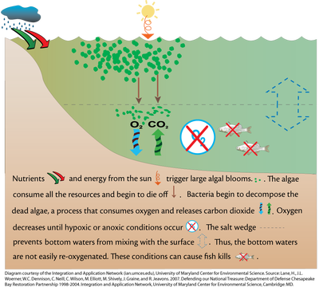

Slide 19
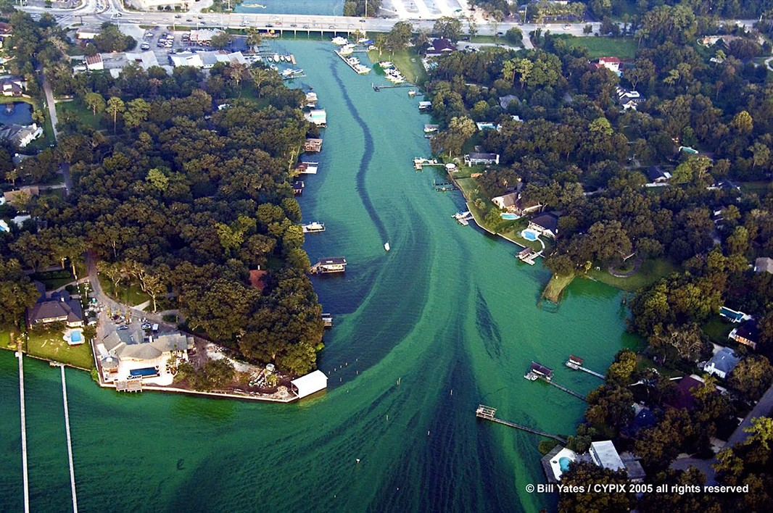

Slide 20
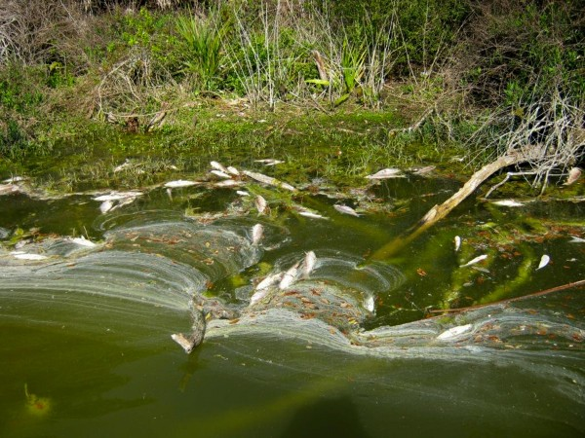

Slide 21
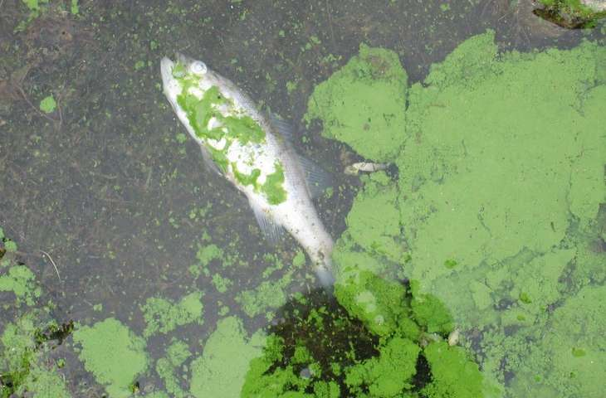

Slide 22
Can you think of a simple way to improve dissolved oxygen levels in a water body?

Slide 23
Turbidity

Slide 25
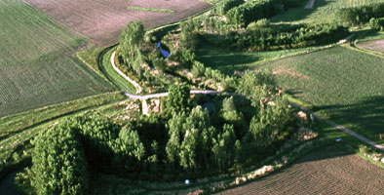
Notes:
25

Slide 26
Salinity

Slide 27
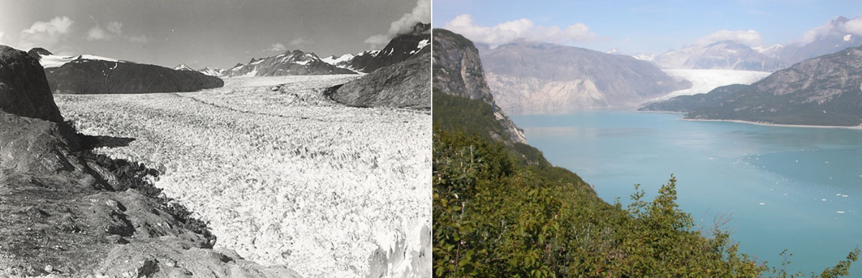
2
Notes:
27

Slide 28
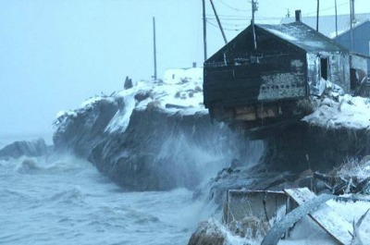
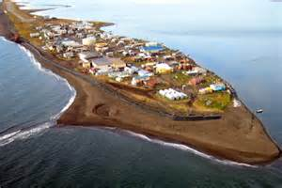
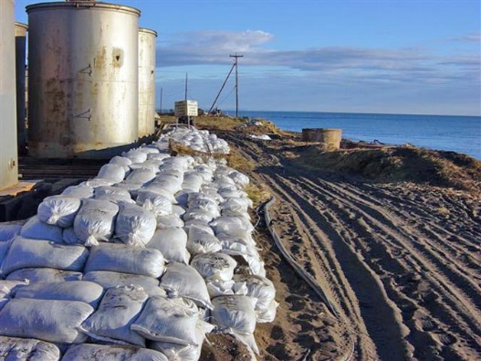
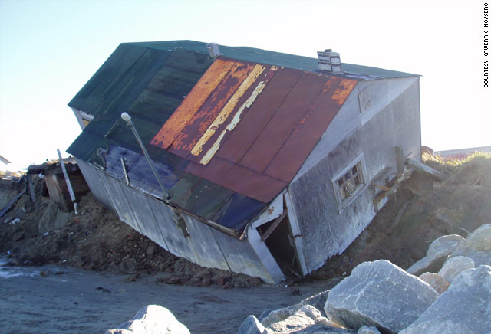
Kivalina, Alaska
First U.S. climate change refugees
Barrier Island
8-10ft thick sea ice mostly gone
Underwater by 2025
“What we're facing is real.” "It is threatening our livelihood, our culture, our way of life. We are a people who are able to adapt to changes, but we need to move our village.“ – Mike Hawley, president Native Village of Kivalina

Slide 29
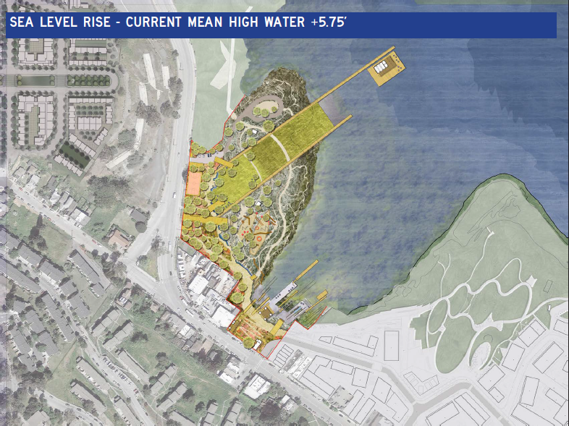
Notes:
Used Assessment, TBA, Areawide Planning, Cleanup, Land Revitalization TA
Great example of shoreline softening
Initiating development plans with adaptation to CC in mind

Slide 30
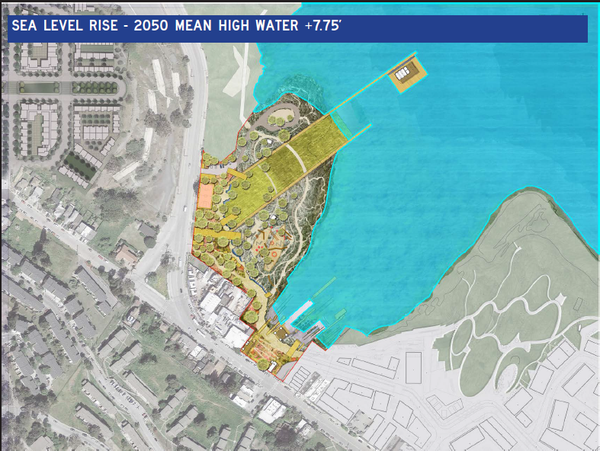

Slide 31
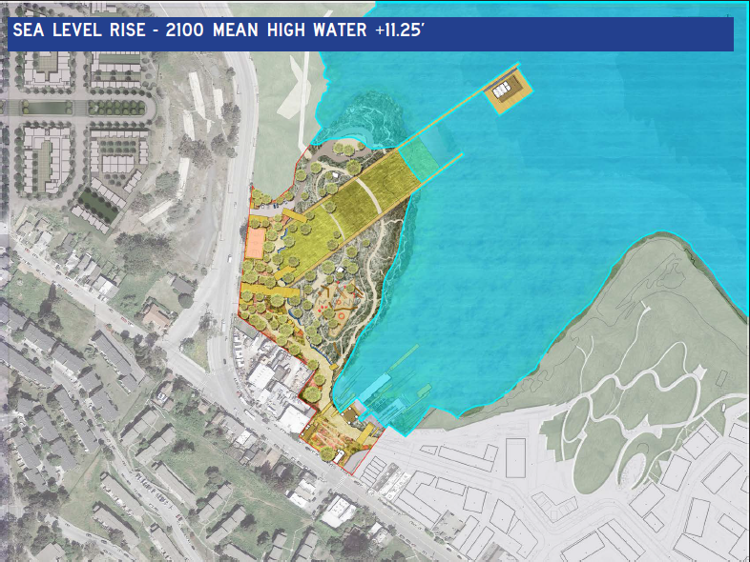

Slide 32
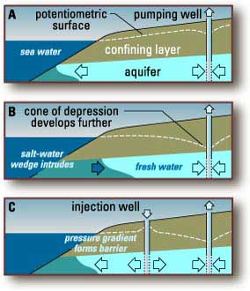

Slide 33
pH

Slide 35
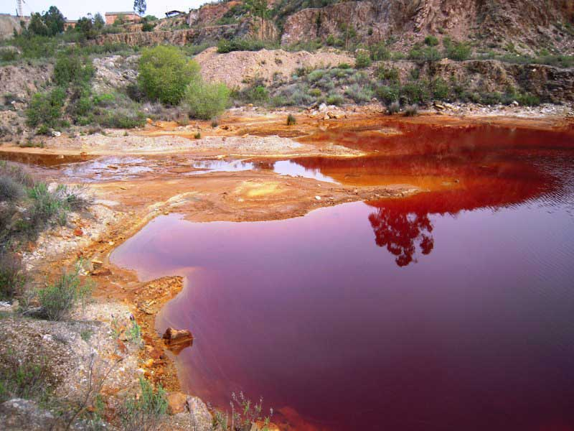

Slide 36
What’s the point of water monitoring anyway?

Slide 37
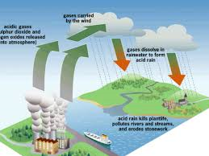
Acid Rain

Slide 38
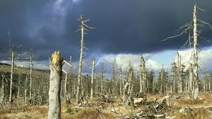
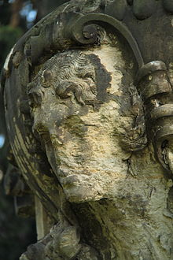

Slide 39
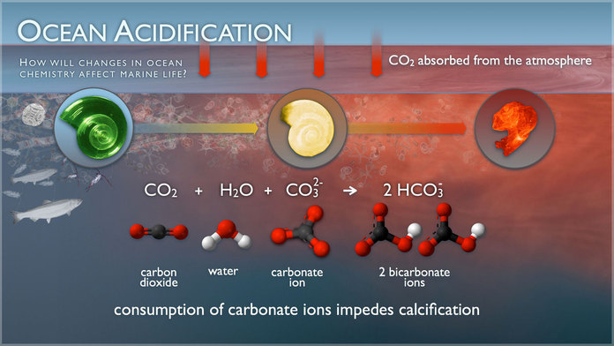

Slide 40
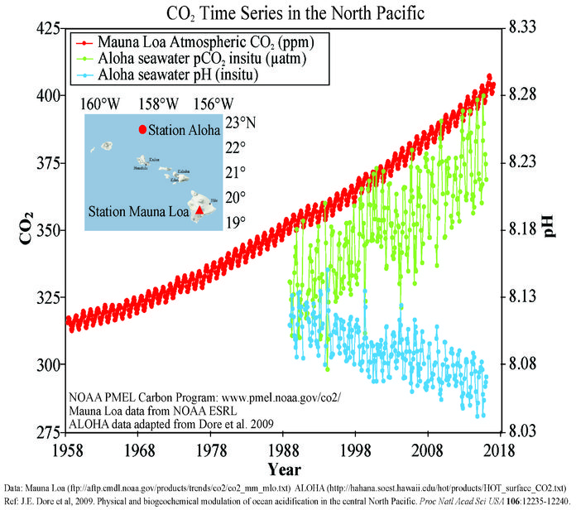

Slide 41
What can make laws that protect water quality difficult to enforce?
Can you think of groups that might oppose water quality laws? Why the opposition?
What role does water monitoring play?

Slide 42
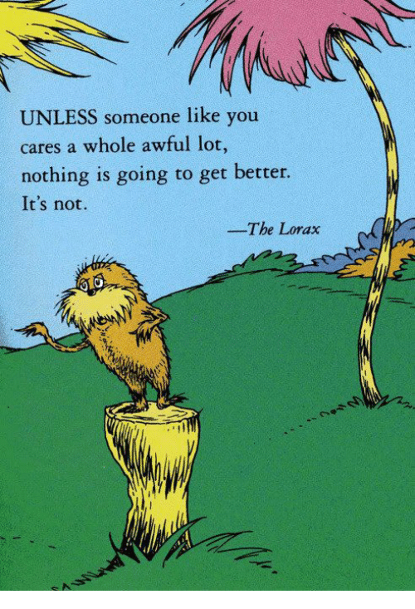

Slide 43
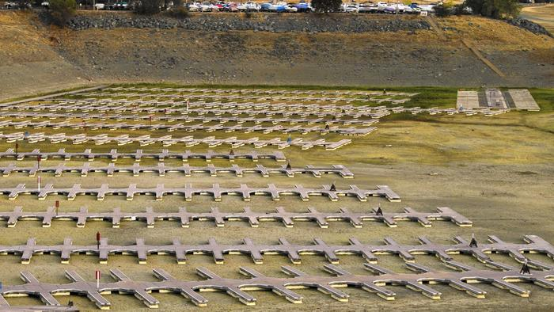

Slide 44
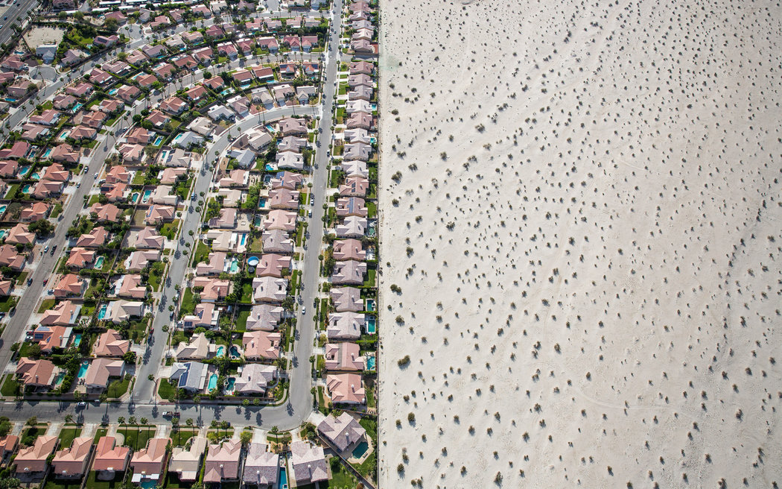

Slide 45
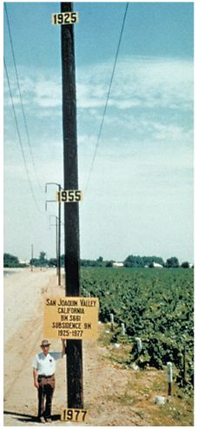

Slide 46
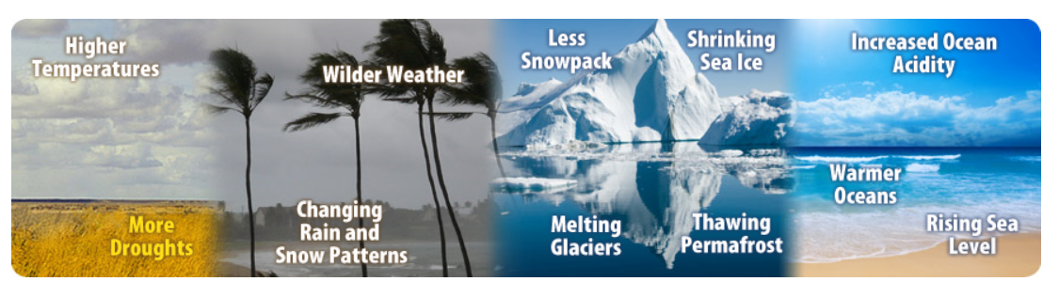
What is Changing?
Notes:
46

Slide 47
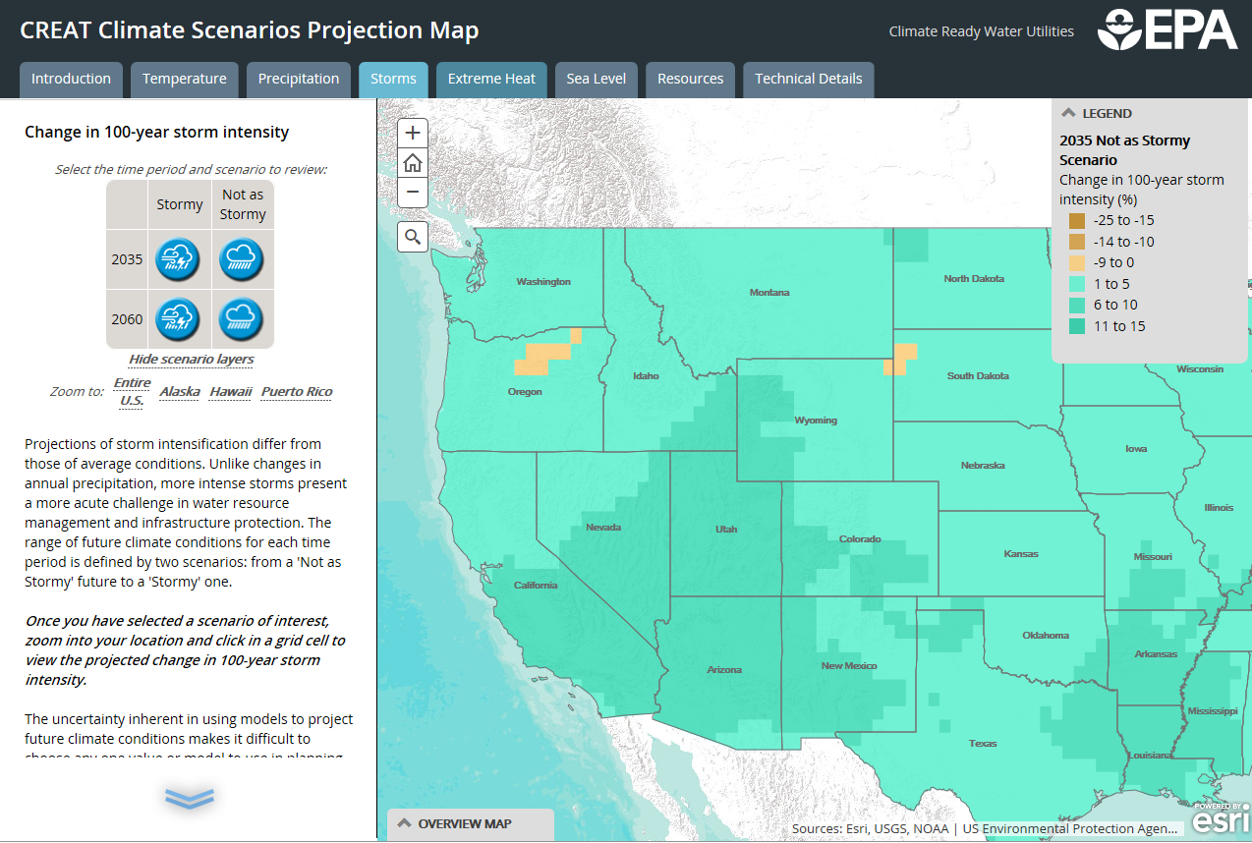

Slide 48
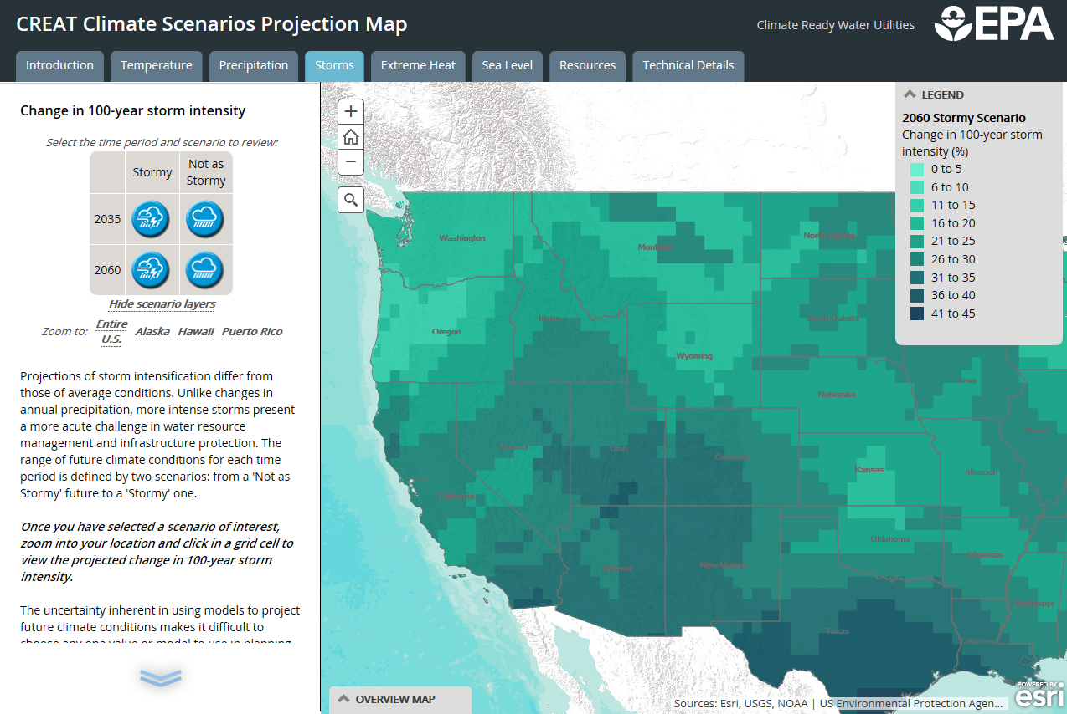

Slide 49

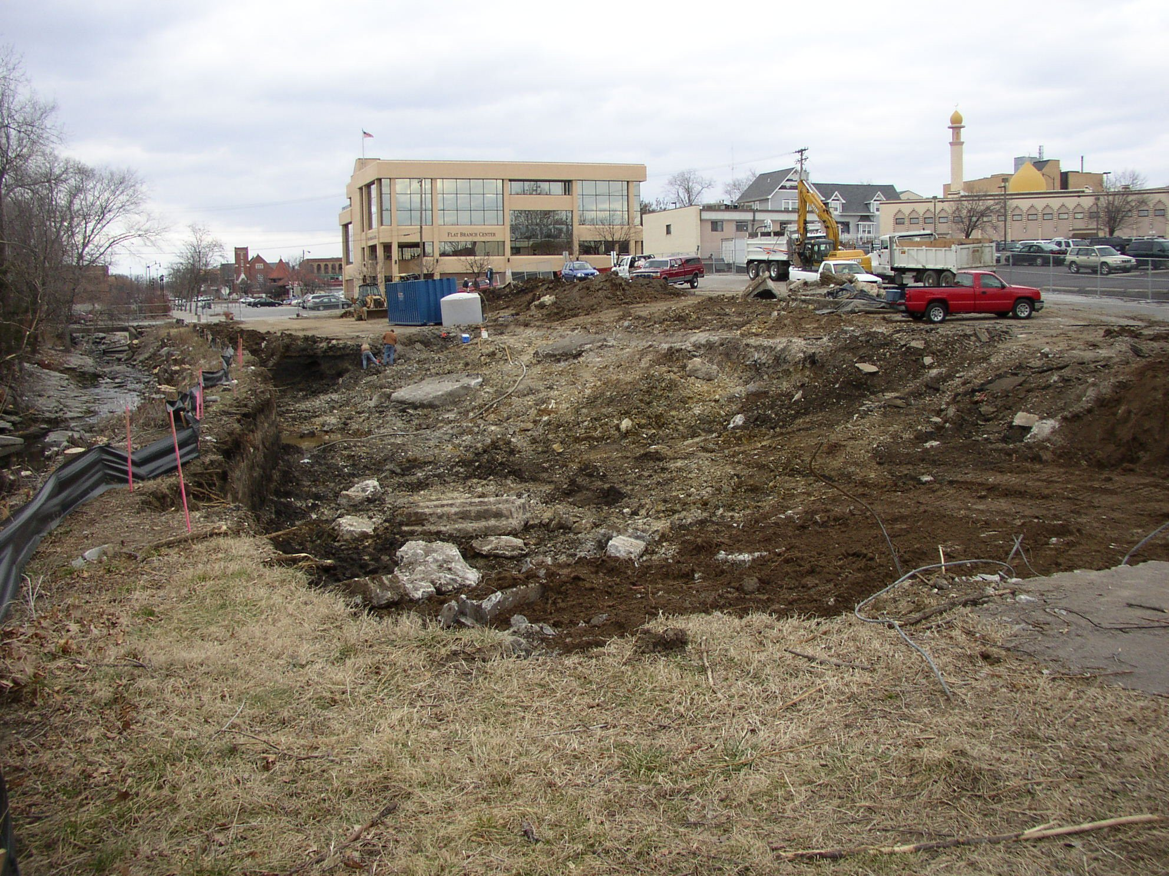
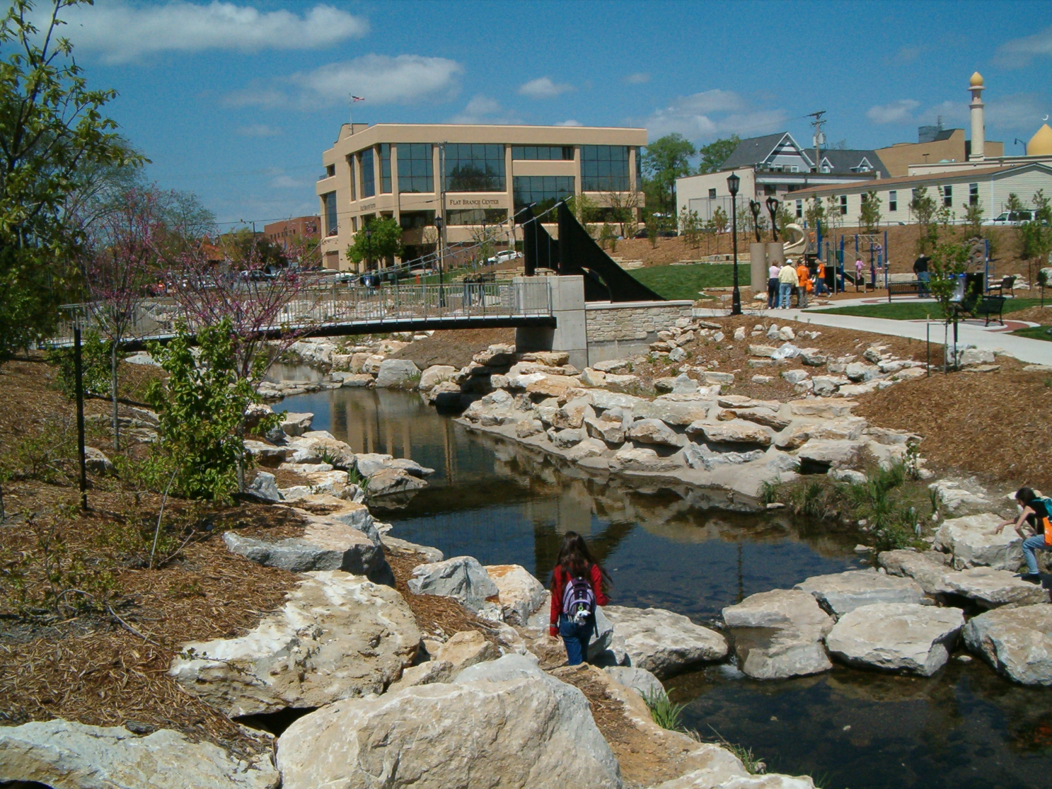
Green Infrastructure Role in Cleanup
Columbia, Missouri – Day lighted Stream and Landscaping
Before: Former bulk oil facility
After: Award-winning park with rain garden
Notes:
> Through the cleanup process, over 7,500 cubic yards of oil-contaminated soil were removed from the property, as well as 12,000 gallons of contaminated water.
Flat Branch Park now serves as a center of community activity with a playground, spraygrounds, benches, a stormwater rain garden, an amphitheater, sculptures by a local artist and a gazebo that may be reserved for special events. The landscaping at the park received the Gold Leaf Award from the Midwestern Chapter of the International Society of Arborculture (ISA). This award is given annually to an individual or community that has used landscaping to enhance environmental protection, conservation and beautification.
Source: https://www.epa.gov/sites/production/files/2015-09/documents/columbia_mo.pdf

Slide 50
Notes:
50
Don’t forget mitigation and outside investment through PPAs, etc.

